Slide 1
Forests For Tomorrow
2014/15 – 2018/19
Provincial Meeting
September 18, 2013
Allan Powelson,
Monty Locke

Slide 2
VISION
The impacts of catastrophic disturbances and constrained timber supplies are: (a) identified, prioritized and communicated to government to support investment decisions; and (b) consistent with those decisions, the impacts are effectively and efficiently mitigated by exemplary stand tending and reforestation activities that enhance forest values and support forest resilience.
MISSION
FFT optimally utilizes available funding to reforest and manage productive forest land through the use of best science, and in consideration of all forest values and changing factors.

Slide 3
Eligible Investment Category | Sub-Category | Focus | Implementation Priorities
Forests for Tomorrow Program | Current reforestation | Priority given to those areas throughout the province where the catastrophic disturbance has caused drops in mid- and long-term timber supply. Eliminate backlog NSR. | Maintain adequate growth rates on existing government-funded land based investments through vegetation management. Annual reforestation level of 20 million seedlings (at least) with a variety of species, on areas where the mid- and long-term timber supply has been impacted by catastrophic disturbance. Meet government obligations under Forest and Range Practices Act section 108. Eliminate the provincial backlog (pre-1987) Not Satisfactorily Restocked (NSR) by 2015.

Slide 4
Eligible Investment Category | Sub-Category | Focus | Implementation Priorities
Forests for Tomorrow Program | Timber Supply Mitigation | Mitigate impacts on timber supply caused by catastrophic disturbance or constrained timber | MPB impacted areas Fertilization, spacing, and conifer release in the central Interior will focus on mitigating the reduction in the mid-term timber supply by targeting these activities within the “economic fibre-baskets” associated with the priority areas: Spacing treatments should be focused on managing density of repressed, or potentially repressed, stands with low forest health risks. Stands and spacing densities should be targeted for future fertilization treatments and value improvement. Coast, NW, SE Fertilization , spacing, and conifer release on coastal, southeast, and northwest forest management units with constrained timber supply and where highest return-on-investment will be achieved to improve timber availability and value. Focus on establishing stands suitable for future fertilization and value improvement.

Slide 5
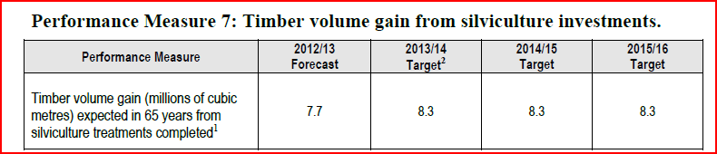

From the service plan

Slide 6
Government Commitments
Current reforestation
Plant at least 20 million seedlings per year
Eliminate the backlog NSR by 2015
Increase funding by $10 million starting in 2015/16
Timber Supply Mitigation
Continue developing Type 4 Silviculture strategies
Fertilize at least 21,000 ha per year

Slide 7
Determination of level of investment in each region of the province will be based upon the level of need and opportunity for mitigation of impacts on timber supply caused by catastrophic disturbance or constrained timber

Slide 8
2014/15
2014/15 FFT budget projected to be around $32 M for CR and around $11.85 M for TSM
Direction from Premier to Minister to increase funding for “reforestation” by $10 M starting in 2015/16

Slide 9
Finding treatable areas
FFT potential opportunity maps
  Areas that might be not sufficiently stocked were determined using the vegetation resource inventory, provincial overview surveys for forest health, perimeters of wildfires since 1999, current harvested stand updates, and the mapped boundaries of the timber harvesting land base.
Silviculture opportunity maps
  Finding opportunities for a variety of incremental activities
Digital Camera and other high resolution imagery availability.
  Available from FAIB and GeoBC

Slide 10
Guidance for developing the AOP and 5-year plan
Planning
Forest For Tomorrow Strategic Plan
Silviculture planning process
  FFT silviculture 5-year plan instructions
  Silviculture treatment regimes
Stand Management Guidance
Silviculture treatment funding criteria (Minor changes reflecting regional input)
Management of tree species composition
FFT species and density indicators and targets
Mixed species options for FFT
Assisted Species Migration
FFT use of western white pine guidance
Silviculture regimes for fuel management
Fibre Plantations In British Columbia (Land Based Investment Program)
Return on Investment
ROI Information / Training / Guidance documents

Slide 11
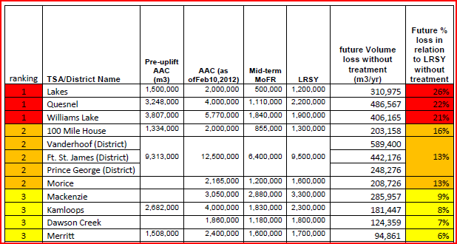
Priority ranking for current reforestation treatment as 2013
(indication of TSA name includes all management unit types – tree farm licences, Community Forests, and woodlots - encompassed by that broader area in priority ranking)

Slide 12
Additional aspects that impact this priority listing
Caribou mitigation openings
  Incorporating the crop establishment opportunities into plans
  strategically adjust less critical activities which can be achieved on alternative timelines
  Random events outside priority areas
  what should the strategic approach be for these opportunities?
  What should be the criteria that we use to ensure that we do not miss stewardship opportunities that can be locally important but are outside of the main provincial priority areas?

Slide 13
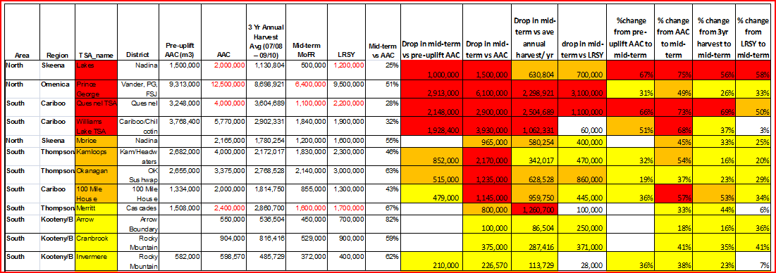
Priority ranking for timber supply mitigation treatment as 2013
(indication of TSA name includes all management unit types – tree farm licences, Community Forests, and woodlots - encompassed by that broader area in priority ranking)

Slide 14
Additional aspects that impact this priority listing
2014/15 LBIS Draft Budget for TSM ($11.85 million)
Incorporation of Woodlot Associations and Community Forests
70/30 Interior Priority Units /Coastal, NW, SE split
Interior Priority areas – focus on priority one areas first in addressing mid-term timber supply gap
Coastal, NW, SE – use AAC to assign funding levels
Notes:
The budget level impacts the ability to address the work identified in the priority and constrained areas. In 2012/13, TSM had a $12 million program with $7.25 million in pre-purchase fertilizer from 2011/12 surpluses for a total expenditure of $19 million. For 2014/15 the fertilizer will need to be purchased from the $11.85 million budget. 2014/15 will be a year of ramping back up from no activities in 2013/14.
The incorporation of Woodlot Associations and Community Forests into the FFT planning process this year will also need consideration if trade-offs are to be made at the regional level. The province supports the involvement of the WLAs and CF in the FFT program and has set a target of $1 million in projects across both CR and TSM. We are currently at $1.1 million provincially so if budgets need to be reduced we need to discuss how the level of involvement can be maintained at the target level for 2014/15.
At the provincial level the budget has been split based on total AAC for the interior priority units and all other areas. The 30% for the constrained areas is focused on areas which have self identified a constrained timber supply.

Slide 15
Provincial summary

Slide 17
BCTS provincial summary

Slide 18
Forward planning
Essential to use RESULTS forward planning
Important that the information planned in RESULTS is accurate.
  STILL working towards GENUS/RESULTS automatic connection
  Till then will produce data dumps from GENUS to place into RESULTS. (talk to Dominy and MacLeod)

Slide 19
Difference between RESULTS completed vs FFT Funded Goals in 2012/13 – activities planned but reported did not match

Slide 20
Next steps:
September 30th- Budget based on draft plan submitted as part of LBIS
November 1st - LBIS budget submitted to Deputy
December 31st - 2014/15 AOP 2nd draft firm based on projected budget
March 1st - 2014/15 AOP finalized based on received budget
April 1st – 2014/15 AOP actioned
Notes:
- The FFT planning process like other investment categories such as forest health, fish passage etc feeds into the overall LBIS planning cycle;

Slide 21
Questions?
Info: FFT web-page http://lbis.forestpracticesbranch.com/LBIS/node/1059
Contacts: Al Powelson allan.powelson@gov.bc.ca , Monty Locke Monty.Locke@gov.bc.ca

